Slide 1

Mirror, Mirror: Critical Reflection for Equity-Oriented Practice
Come-back Session
March 8-9, 2023

Slide 2
Agenda
Day 2
Connector
Presentations
Wrap-Up

Slide 3

CONNECTOR
A thorn, a bud, and a rose
Thorn: One thing that was challenging, that you would have liked to be different, or something you did not enjoy.
Bud: A new idea you hope to develop based on the feedback and discussion.
Rose: Something that was positive, something you are proud of, or something you liked.

Slide 4

Pulse Check

Slide 5
MENTIMETER RESULTS

Slide 6

TEAM TIME!
Finalizing your Pecha Kucha

Slide 7
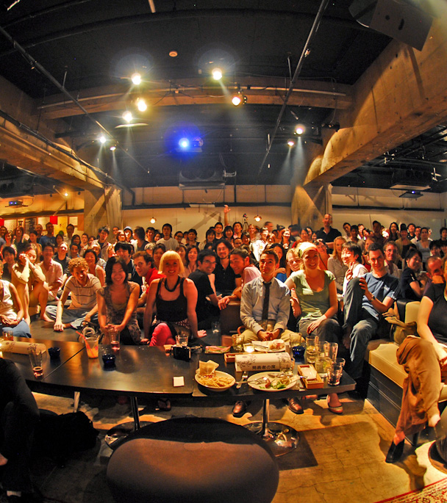
IT’S PECHA KUCHA TIME!

Slide 8
PROCESS
Each team will present their Pecha Kucha
Followed by Q&A
Order of Presentations:
Equity Literacy and Critical Reflection
Vignettes
Vignettes with MRS
Inclusive Instruction Rubric

Slide 9

CONVERSATION CAFÉ
Individual Reflection:
Write down your key takeaways or lingering questions following the presentations
This Photo by Unknown Author is licensed under CC BY-ND

Slide 10
CONVERSATION CAFÉ
Round 1: Table Talk
Learnings & Lingering Questions:
What are your key takeaways?
What questions are still circling in your mind?

Slide 11
CONVERSATION CAFÉ
Round 2: Application
What is one way you can apply these learnings to your program or your work?
What’s next for you in continuing this work?
Where do you see opportunities to collaborate in furthering this work?

Slide 12

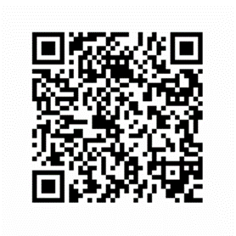
EVALUATION
Your Feedback is Important to Us!!
https://survey.alchemer.com/s3/7245836/2023-03-Spring-Come-Back-Session-Reflection

Slide 13

BranchED Circle Talk
Speaking from the Heart; Listening With Respect
The Significance of Circles
  Circles are symbolic in many cultures and contexts
  Circles represent equality, interconnectedness, and continuity
  Circle Talk is built on the belief that every human being wants to be connected to others in a good way
  Circles build community

Slide 14


Reflection and Anticipation

Slide 15

Don’t Forget
Grab your Box Lunch
Safe Travels!!

Slide 16
Thank you for your time!
info@educatordiversity.org
(800) 519-0249
www.educatordiversity.org

