Slide 1

Essential Foundational Practices for Success:
Taming the Early Literacy Giant
March 9, 2023

Slide 2
Agenda
Day 2
Welcome and Connector
Pulse Check
BranchED Framework for Quality Educator Preparation: Deep Dive
Team Time
Crowd Sourcing
Closing

Slide 3


Connector
How well can you read emojis?

Slide 4

Pulse Check

Slide 5
Mentimeter
Your Feedback is Important to Us!
Add Results from MentiMeter

Slide 6
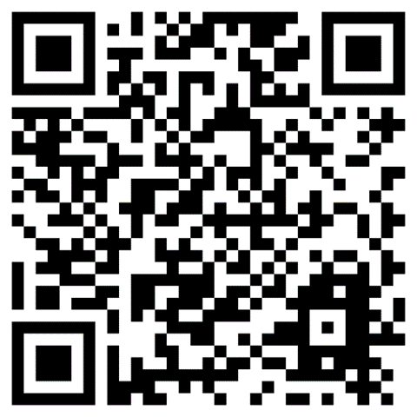

Summit Webpage
Accessing Resources

Slide 7

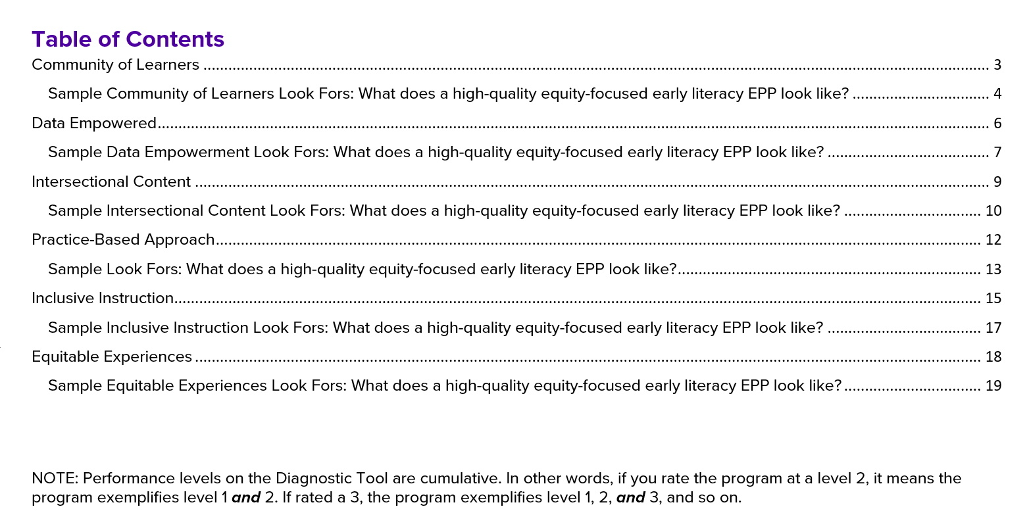
Introduce Diagnostic Tool
Early Literacy Focus

Slide 8

Community of Learners

Slide 9
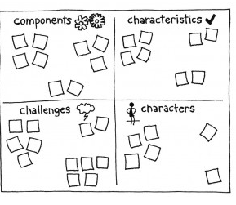
What is a Community of Learners
The 4 Cs
Components are parts of the topic.
Characteristics are features of the topic.
Challenges are obstacles associated with the topic.
Characters are people associated with the topic.
Game Storming: A Playbook for Innovators, Rulebreakers, and Changemakers
Notes:
Components are parts of the topic. For example, a component of a social commerce strategy might be responsive tweets. Components of a distribution channel might be 18-wheelers.
Characteristics are features of the topic. For example, speed of response is a characteristic of a social commerce strategy. A characteristic of an 18 wheeler might be an inefficient use of fuel.

Slide 10
The 4 Cs
Process
Divide into 4 teams you will have access to sticky notes/markers
Each team is to collect information about your “C”, specific to Community of Learners
You will have three minutes to plan an information-gathering strategy.
You will have five minutes to collect the information.
You will have three minutes to analyze and organize it.
YOU SHOULD COLLECT INFORMATION FROM AS MANY PEOPLE IN THE ROOM AS POSSIBLE!
Notes:
4Cs – Gamestorming

Slide 11

Community of Learners
Discussion
EPP
PK-12 Partners
Teacher Candidates
PK-12 Students
Families & Communities
Characters
Characteristic
Component
Challenges

Slide 12
Principle 1: Community of Learners
Quality educator preparation is catalyzed by a broad-based Community of Learners. The Educator Preparation Provider (EPP) establishes a community of learners through leadership, shared responsibility for candidate learning, and professional collaboration.

Slide 13
Sample Community of Learners Look Fors
What does a high-quality equity-focused early literacy EPP look like?
The program, PK-12 partners, and other key stakeholders co-create the design of the literacy program and determine literacy priorities.
The design and literacy priorities utilize aspects of Universal Design for Learning that provide flexibility, voice, and choice.
Collaboration ensures representation from families and community to guide and adjust current practices and develop, implement, and evaluate the success of new initiatives/goals.
The program engages stakeholders in the development of signature assignments/assessments that meet the needs of culturally and linguistically diverse students and differently abled students.
The program engages PK-12 partners and other key stakeholders in analysis of Teacher Candidate (TC) performance on signature assessments and high-stakes assessments (e.g., certification exams) to identify and respond to strength areas and areas in need of improvement.
Stakeholders engage in collaborative programmatic decisions that impact TC’s success on licensure assessments.

Slide 14
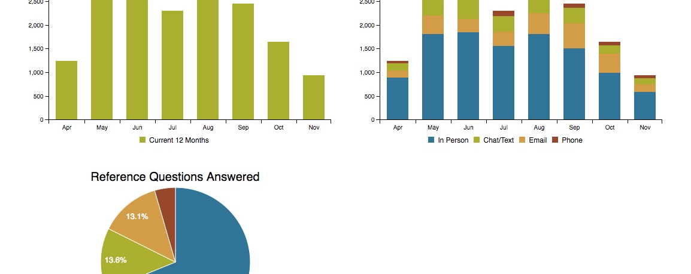
Data Empowerment
This Photo by Unknown Author is licensed under CC BY

Slide 15

Data Empowerment
Empowering individuals and the collective to access and engage with their own data to improve their community through an authentic and ongoing cycle of data collection, analysis, action, and reflection, which assists with addressing and dismantling issues of inequity and correcting unsubstantiated assumptions.

Slide 16
Table Talk
How do you use data in your settings?
What data do teachers/candidates engage with on a regular basis?
What does that look like?
Is there a systematic process for data discussions?
How do you share data with each other?
How can you work together to ensure teachers and candidates are data literate?

Slide 17

Share Out
This Photo by Unknown Author is licensed under CC BY-SA-NC

Slide 18
Principle 2: Data Empowerment
Quality Educator preparation is Data Empowered. The EPP has an active culture of inquiry, utilizing an authentic and ongoing cycle of evidence-based improvement that begins with asking thoughtful questions, moves through organizational learning and action, and ends with an evaluation of the effectiveness of actions taken.

Slide 19
Sample Data Empowerment Look Fors
What does a high-quality equity-focused early literacy EPP look like?
The program has a systematic, inclusive process for capturing, analyzing, interpreting, and acting upon candidate performance data that includes PK-12 and other key stakeholders.
The program maintains an equity focus in designing assessments and analyzing data and ensures the use of culturally responsive data practices to monitor candidate success.
The program uses data collected from the teacher certification exam (e.g., Science of Teaching Reading Exam) and other sources to inform course/program revisions and provide additional support for teacher candidates.
The program examines multiple years of candidate performance data to proactively identify, reflect on, and act upon trends to better prepare TCs to teach early literacy.
The program provides TCs with a comprehensive and critical understanding of assessments used in early literacy including universal screening, diagnostic assessments, progress monitoring and formative assessments.
TCs have an opportunity to understand how teacher reflection on and of practice informs their instructional approaches to best support children’s early literacy development.

Slide 20
Reflection
Annotate the Look Fors Document
Ideas or goals that your EPP and PK-12 partner are doing well ​
Information that doesn’t make sense or you are curious about​
Ideas or goals that your EPP and PK-12 partners could grow in ​
Ideas your team agrees on and thinks are very important
Annotations are a good way to dive deeper into text. Use the following symbols to annotate the Look Fors Document.

Slide 21

Break Time!

Slide 22
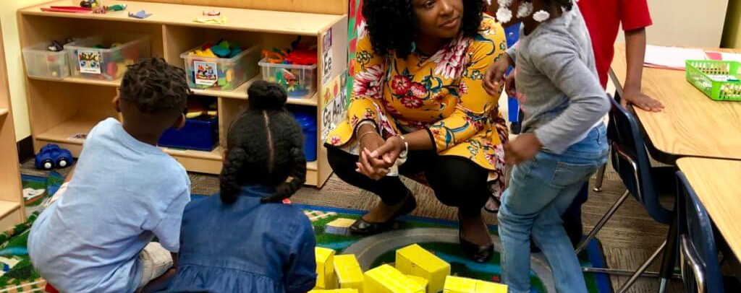
Intersectional Content

Slide 23
Intersectional Content
Pedagogy
Learner
Content
One-Minute Quick Write
What do you believe in-service and pre-service teachers need to know and do to be effective early literacy teachers?

Slide 24
Principle 3: Intersectional Content
Quality educator preparation is grounded in Intersectional Content. Before program completion, candidates demonstrate mastery of content related to learners, learning, the subject matter, content knowledge for teaching, pedagogical knowledge, assessment, and engagement with families and communities. Such knowledge is dynamic, constructed and overlapping.

Slide 25
Intersectional Content
A coherent curriculum has vertical, horizontal, subject area, and interdisciplinary coherence.
The EPP and PK-12 partners recognize the importance of continuous improvement and regularly:
Map the literacy curriculum, national standards, and the Science of Reading.
Review standards implementation, assessment tools, and student performance.
Coherent, Standards Aligned, Content Knowledge, Use of Knowledge for Teaching
The Glossary of Education Reform. Curriculum Mapping. https://www.edglossary.org/curriculum-mapping/

Slide 26
Intersectional Content
Analyzing the curriculum and making instructional decisions are essential skills for all teachers.
Teachers and Candidates should be able to:
Evaluate specific literacy programs.
Seek alternatives or additions to programs and materials if materials are not high-quality and do not align with SOR research and theories.
Advocate for change in literacy programs, materials, and assessments.
Share literacy content and pedagogy with all stakeholders, including parents.
Curriculum Literacy
Steiner, D., Magee, J., Jensen, B., & Button, J. (2018).
Notes:
Steiner, D., Magee, J., Jensen, B., & Button, J. (2018). Curriculum literacy in school of education? The hole at the center of American teacher preparation. John Hopkins Institute for Education Policy-Learning First. Retrieved from https://learningfirst.com/wp-content/uploads/2020/07/8.-Curriculum-literacy-in-schools-of-education.pdf

Slide 27
Intersectional Content
“To provide the best support to school children, student teachers [and inservice teachers] must think critically about their practice as an individual and in interaction with others in a learning community…and develop abilities to resolve issues” (p.80).
The EPP and District fosters equity and asset-based literacy practices and in-service teachers and candidates:
Articulate the role of bias, inequities, power, and privilege in the literacy classroom.
Evaluate resources, strategies, and patterns of discourse for contribution to diversity, equity, and inclusion in literacy.
Select and defend asset-based literacy assignments, activities, and materials based on DEI.
Cultivates a Critical Orientation
Liu, P. (2022)
Notes:
Liu, P. (2022). Reflection in alignment to professional standards: What did the student teachers highlight? Journal of Global Education and Research, 6(1), 67-81. Retrieved from https://digitalcommons.usf.edu/cgi/viewcontent.cgi?article=1111&context=jger

Slide 28

Intersectional Content
The Missing Pieces Activity
Objective: Participants will identify possible missing “pieces of a puzzle” by identifying
indicators of the intersectional content area that may not be considered in the scenario.
Tool: Intersectional Content Rubric
Scenario: A teacher candidate developed a series of lessons to teach comprehension. She followed the district curriculum program and the teacher educator’s strategies for teaching reading. Although the teacher used the second-grade curriculum and student data to determine lesson content, over 80% of her students did not meet benchmark on the district comprehension assessment.
In the weekly seminar, the teacher candidate expresses concern about her teaching effectiveness. What pieces of intersectional content must the EPP and School/District consider as they strive to continue developing the teacher candidate’s literacy understanding?

Slide 29

Intersectional Content
The Missing Pieces Activity
Objective: Participants will identify possible missing “pieces of a puzzle” by identifying indicators of the intersectional content area that the EPP/School/District might consider while addressing the issues outlined in the scenario.
Share 4 considerations.
Be prepared to share the “why.”

Slide 30
Sample Intersectional Content Look Fors
What does a high-quality equity-focused early literacy EPP look like?
The program ensures that practices are aligned with early literacy practices in the field (i.e., Science of Reading, oral language development, evidence-based practices that support multilingual PK-12 students).
The program faculty, PK-12, and other key stakeholders collaboratively develop candidate competencies that encompass skills, literacy and assessment content, and dispositions that candidates must demonstrate upon completion of the program.
The program faculty ensure the introduction, purposeful practice, and use of evidence-based, high-quality curriculum throughout all coursework. Practice opportunities are scaffolded and allow students to actively demonstrate and build upon their funds of knowledge.
The program provides access to asset-based approaches in early literacy.
The program provides numerous opportunities to build relationships and literacy knowledge and affirms and validates teacher candidates’ identity and interests.
TCs have access to a wide variety of field experiences (e.g., co-taught, diverse, inclusion...) that model the use of high-quality, evidence-based literacy practices.
TCs have opportunities to critically evaluate early literacy curriculum, materials, and assessments to ensure representation of multiple dimensions of diversity (e.g., socioeconomic, racial, ethnic, linguistic...).

Slide 31
Team Time
Current Level of Implementation
Reflect on your current level of implementation.
What is needed to move to the next level?
Collaboration with District Partner | Collaboration with EPP Partner

Slide 32

LUNCH TIME!

Slide 33
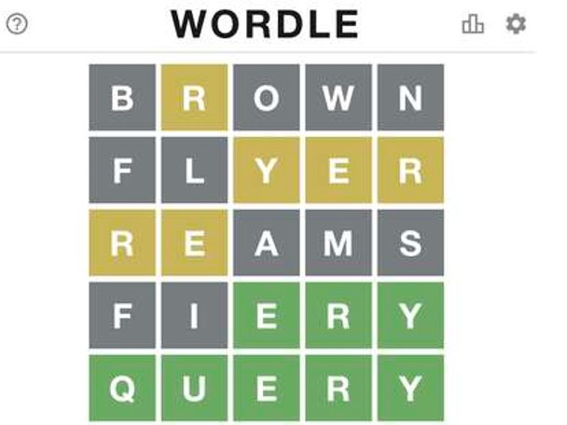
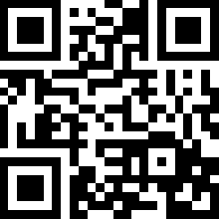
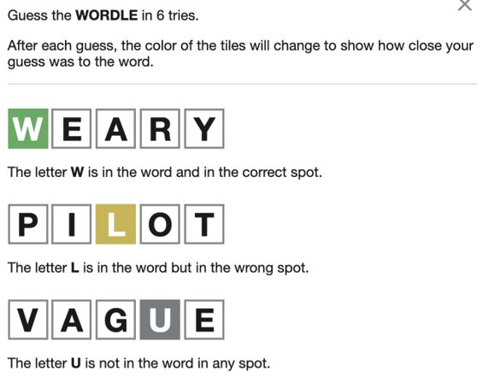
Wordle
http://tiny.cc/summitwordle23
Notes:
Make Your Own Wordle (strivemath.com)

Slide 34

Quick Review
What have we learned so far?
This Photo by Unknown Author is licensed under CC BY

Slide 35

Practice-Based Approach

Slide 36
Practice-Based Approach
Gallery Walk
Share one of your favorite evidence-based literacy activities that you have seen when observing pre- or in-service teachers?
What components made it an effective literacy activity?

Slide 37
Principle 4: Practice-Based Approach
Quality educator preparation is experiential and Practice-Based. The EPP purposefully engages candidates in direct experience of teaching (practice) and focused reflection, in order to increase knowledge, develop skills, clarify values, and develop the capacity to contribute to diverse communities.

Slide 38



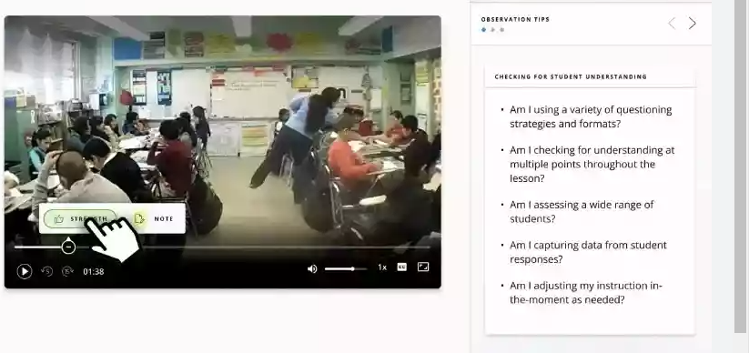
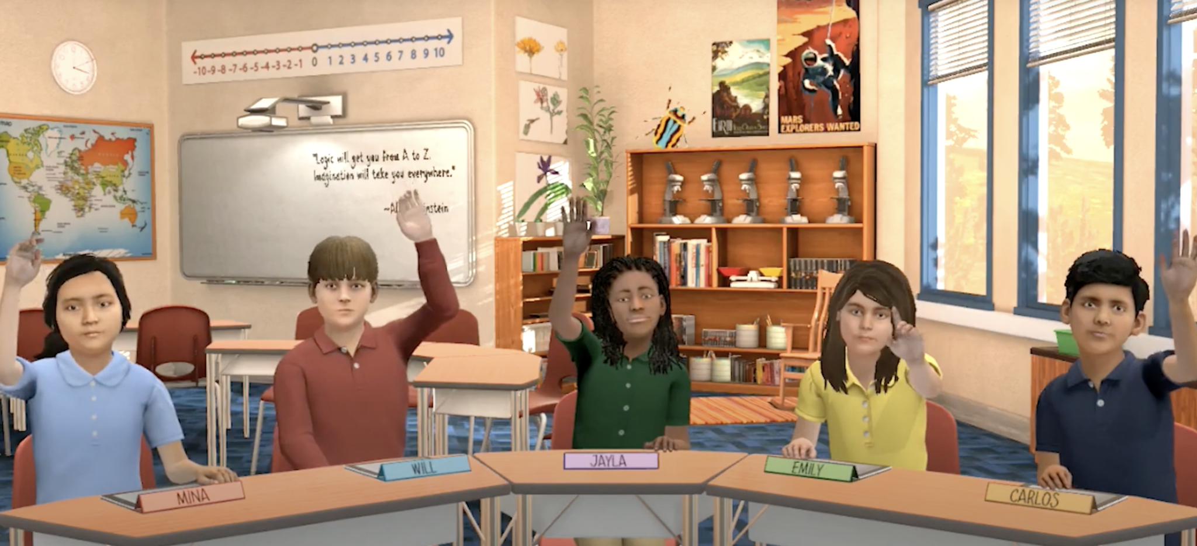
Purposeful Practice

Slide 39
Sample Practice-Based Approach Look Fors
What does a high-quality equity-focused early literacy EPP look like?
The program faculty and PK-12 partners model evidence-based literacy instruction and activities in diverse settings.
The program faculty and PK-12 partners provide literacy coaching for TCs.
The program ensure course work and field experiences are scaffolded to support TCs’ skill development in early literacy instruction.
The program provides TCs opportunities to engage with families and communities in meaningful ways.
The program faculty reflect on their practice and engage in professional development to improve their practice.
The program provides TCs an opportunity to engage in literacy-based video observation, microteaching, simulations, and purposeful practice of literacy activities consistent with evidence-based literacy practices (SOR)
The program provides TCs with opportunities to reflect on literacy instruction and assessment that focuses on the whole child.

Slide 40
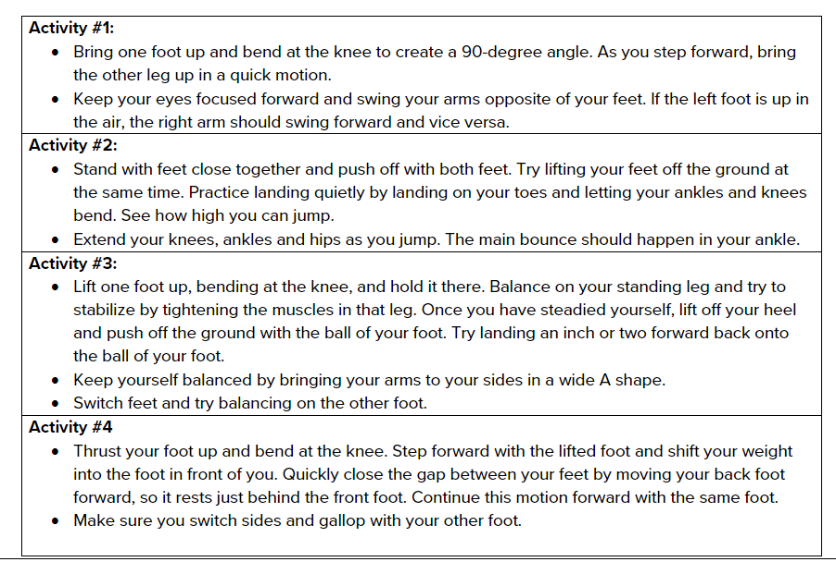
Reflection: Practice-Based Approach
Show Me, Not Tell Me

Slide 41

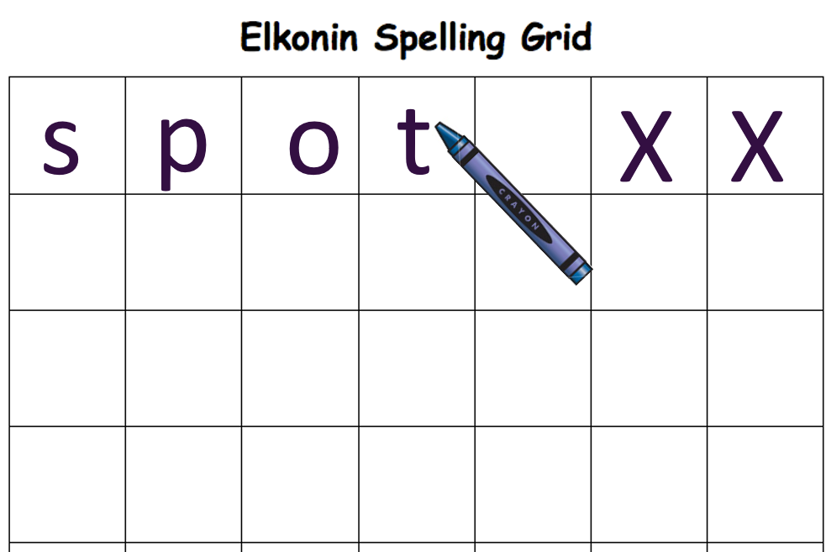
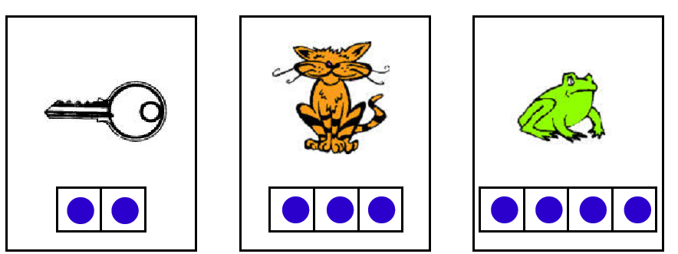
Orthographic Mapping Exercise

Slide 42

Inclusive Instruction

Slide 43

Discussion
What does inclusive instruction mean to you?
This Photo by Unknown Author is licensed under CC BY-SA

Slide 44
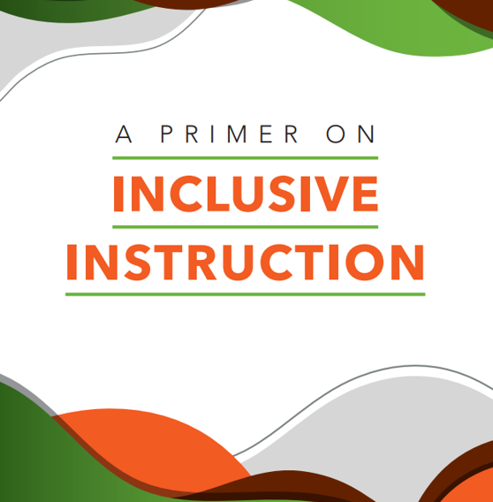
Inclusive Instruction
BranchED Definition
We believe inclusive instruction minimizes or removes barriers to learning or assessment and supports the success of all learners, while ensuring that academic standards are not diminished.
We believe inclusion and rigor are threads in the same cloth.

Slide 45
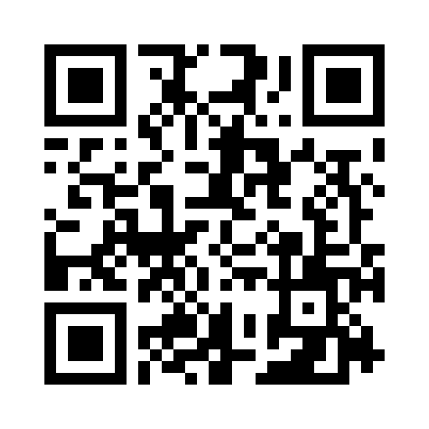

Access the Primer on Inclusive Instruction Through Our Resource Portal
Search Text: Inclusive Instruction

Slide 46
Principle 5: Inclusive Instruction
Quality educator preparation fosters Inclusive Instruction. Inclusive instruction minimizes or removes barriers to learning or assessment and supports the success of all learners, while ensuring that academic standards are not diminished. Such pedagogy includes the integration of culturally and linguistically sustaining practices, social and emotional learning, cognitive science, and trauma informed care.

Slide 47
What is Inclusive Instruction?
Culturally Responsive and Sustaining Pedagogies
Learner-centered environment
  Clear expectations
  Equity literacy
  Instructional design
  Based on funds of knowledge
  Affective engagement- their language is welcomed and valued and see themselves within the curriculum
  Asset-based feedback

Slide 48
What does inclusive instruction look like in early literacy?
Attending to Cultural Realities
Addressing Social Inequities
Equity-Based Instruction
Knowing the Learner
Others?
Connecting to students’ lived experiences and funds of knowledge to increase engagement and learning.
Notes:
Attending to cultural realities
Addressing social inewuities
Equity based instruction
Knowing the learnger

Slide 49
Sample Inclusive Instruction Approach Look Fors
What does a high-quality equity-focused early literacy EPP look like?
The program exemplifies an asset-based approach to literacy instruction.
The program values the funds of knowledge families and communities possess; families and communities are represented through readings, course materials, and purposeful practice opportunities. There is evidence of diverse voices, scholars, and materials.
The program provides opportunities for candidates to see culturally responsive and sustaining instruction in action in PK-12 settings and higher education settings and exposes TCs to multiple perspectives through instruction, materials, and communication styles.
The program assesses TCs’ use of culturally responsive and sustaining pedagogy.
The program faculty further their equity literacy through professional development and proactively respond to address bias, racism, and inequity in education settings (higher education and PK-12).

Slide 50
Musical Chairs
Three Rounds
How do I seek to learn about my in-service and pre-service teachers’ existing knowledge, cultural backgrounds, interests, issues of concern, and family traditions?
What types of assignments, projects, and assessments are necessary to prepare pre-service teachers for working in your schools?
How can the program work with Schools/Districts to continue to develop in-service teachers in this area?

Slide 51
Break Time!

Slide 52

Equitable Experiences
This Photo by Unknown Author is licensed under CC BY-SA-NC

Slide 53

Equitable Experiences
Think-Write-Pass Activity
Imagine that you are a first-generation college student or a first-year diverse teacher, what supports would you want from your teacher education program and/or your school/district?
This Photo by Unknown Author is licensed under CC BY-NC-ND

Slide 54
Debrief
This Photo by Unknown Author is licensed under CC BY-SA-NC

Slide 55
Principle 6: Equitable Experiences
Quality educator preparation ensures Equitable Experiences for all candidates. The EPP provides a multi-layered, holistic system of candidate-specific research-based supports, just-in-time interventions, and enrichment experiences that are informed by data and the identification of candidate-specific needs. These academic and social supports are regularly provided and actively monitored to determine whether activities are effective in meeting candidates’ needs and enabling their achievement.

Slide 56
Sample Equitable Experiences Look Fors
What does a high-quality equity-focused early literacy EPP look like?
The program collaborates with Institutional Advisors to ensure prospective TCs receive accurate information regarding program entrance requirements.
The program has a transparent and systematic process to ensure TCs’ timely progression and completion of program including completion of certification exams.
The program provides TCs with clear and accessible information on program sequence and progression in a timely manner.
The program has a process to monitor TCs’ progression and has structures in place to provide necessary supports and assess the success of those efforts.
The program faculty strive to build strong relationships with TCs.
The program works collaboratively with PK-12 to identify areas of need and collectively work to recruit diverse candidates.
The program and District Partners collaboratively provide induction support to ensure retention of diverse novice teachers

Slide 57
Reflection Activity
Silent Walk
Imagine that a publisher has invited you to write your story as a learner in three chapters. What would the titles be?
Is there a metaphor or central theme that runs throughout your story?​
What influenced your journey to become the teacher you are today?​
How has your sense of yourself as a learner changed over the years?​
How did you see (or not see) equity centered in your own experiences as a learner?​
How will your experiences and what you have learned inform development of an equity-focused early literacy program?

Slide 58
Team Time
Current Level of Implementation
Reflect on your current level of implementation.
What is needed to move to the next level?
Collaboration with District Partner | Collaboration with EPP Partner

Slide 59




Culminating Activity
A-B-C Book on Equity and Early Literacy

Slide 60
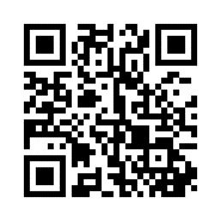

Pulse Check
https://www.menti.com/alkaj62ynf1b

Slide 61


Group Picture (Spirit Wear)
Dinner on Your Own

